Slide 1
Front End Engineering-I Project
1. Name: DEVVRAT DHIMAN
Roll No: 2310990408
2. Name: DHRUPAD KAPOOR
Roll No: 2310990409
3. Name: DHRUV SHARMA
Roll No: 2310990410
Faculty Coordinator: Dr. CHETNA KAUSHAL
:
Chitkara University Institute of Engineering and Technology,
Chitkara University, Punjab

Slide 2
Table of Contents
Introduction
Problem Statement
Technical Details
Key Features
Project Highlights
Code
Conclusion
References

Slide 3
Introduction
COUNTDOWN TIMER
This is a short project assignment submitted by students of Group 5 at
CHITKARA UNIVERSITY
COUNTDOWN TIMER
This a teamwork of three students namely:
1. DEVVRAT DHIMAN (2310990408)
2. DHRUPAD KAPOOR (2310990409)
3. DHRUV SHARMA (2310990410)
The purpose of this project is to display a clock running for a specific period of time with help of HTML, CSS & JAVA Script.
The aim of the project is to help us to understand the concepts of HTML, CSS & JAVA Script from a single project.

Slide 4
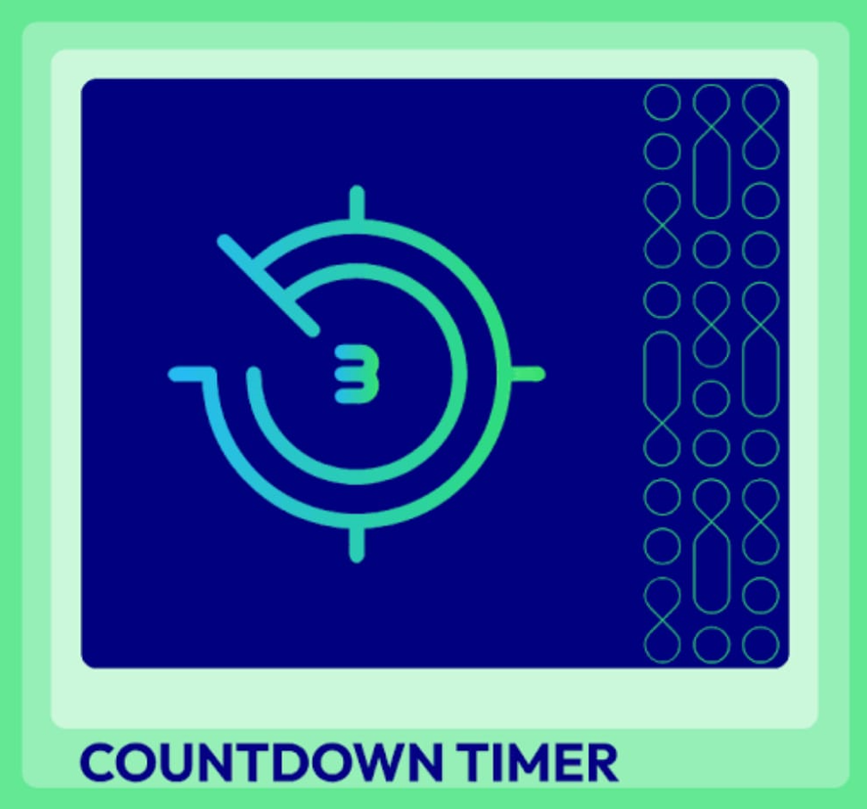

Problem Statement
OBJECTIVE :- To make and display a “COUNTDOWN TIMER” on a webpage using the concepts of HTML, CSS & JAVA Script.

Slide 5

Technical Details
This project “Countdown Timer” is made by using HTML, CSS & JAVA Script.
HTML:- It is used to create basic structure i.e. webpage development of the project which uses various types of tags such as ‘anchor tags(<a>,</a>)’, ‘image tags(<image>)’, ‘paragraph tags(<p>,</p>)’ and many more.
CSS:- It is used to decorate and to add various styles for development of webpage. In our project we had also used CSS tools such as padding, borders, colors etc. to make our project attractive.
JAVA Script:- It is used to create a interactive and dynamic webpage to interact with the users and to execute complex operations. In our project we also used JAVA Script to make the project interactive by making it working project. We have used various terms in our project like ‘script tags’, ‘calling element by it’s id’, ‘concept of variables’ and many more.
VISUAL STUDIO CODE is used as a code editor for this project.

Slide 6
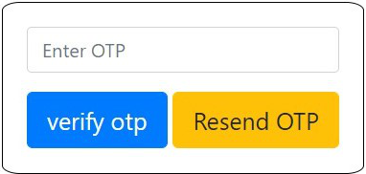
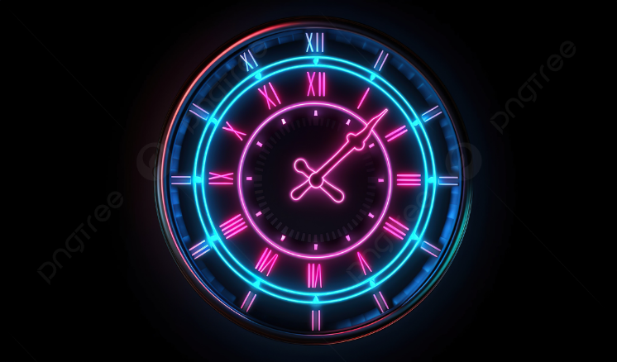
Key Features
The project “COUNTDOWN TIMER” is a very nice project to work upon. It has some unique features too which makes this project UNIQUE in itself.
Some of them are listed below:
First feature of this project is its practical
use in the watches i.e. the stopwatch which
we use in day to day life.
2. Secondly, during some online payments we had been asked to fill the OTP(One Time Password) which is valid for only 1-2 minutes. Basically that is the concept of COUNTDOWN TIMER which is running at the backend of that program.
3. Next use of this project is in the educational field. Students giving online test gets terminated after some fixed interval of time due to running of this program in the background.
4. This program had amplified the efficiency
of all the platforms where it is being used
like in educational field, business and many
other linked platforms.

Slide 7
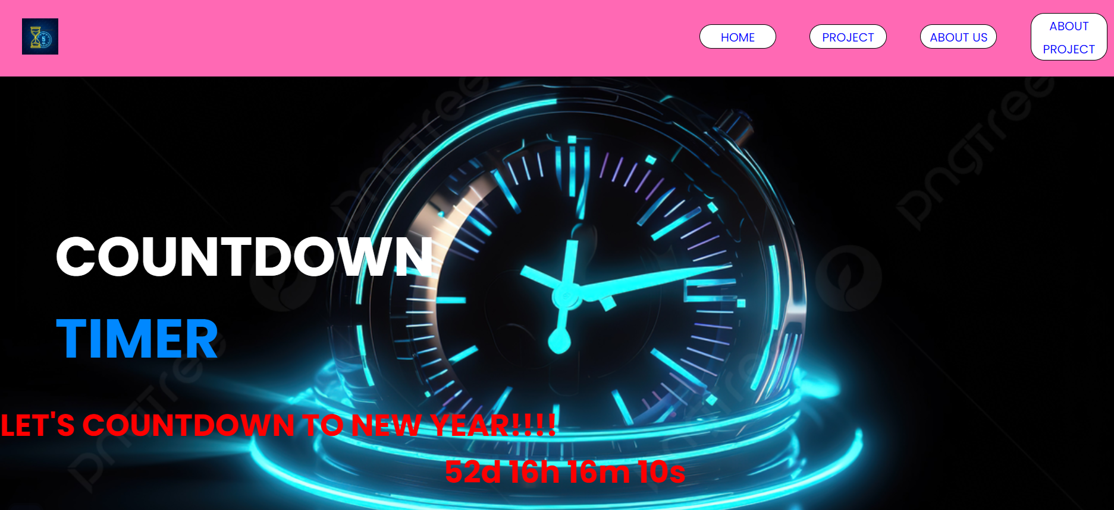
Project Highlights
The highlights of the project “COUNTDOWN TIMER” are:
Use of Animations: The project countdown timer makes use of various animations which are being used from Animate.Css.
Creativity: The creativity in the project is the use of fonts, background images, colors and many more using CSS.
Final Results: The final webpage of this project looks like this

Slide 8
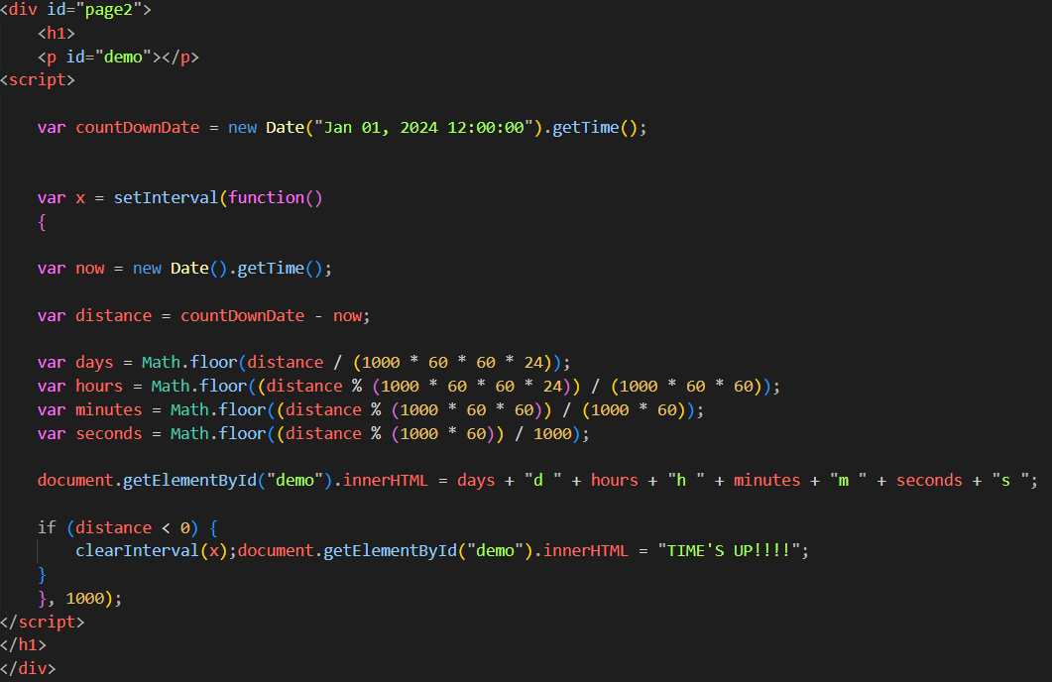
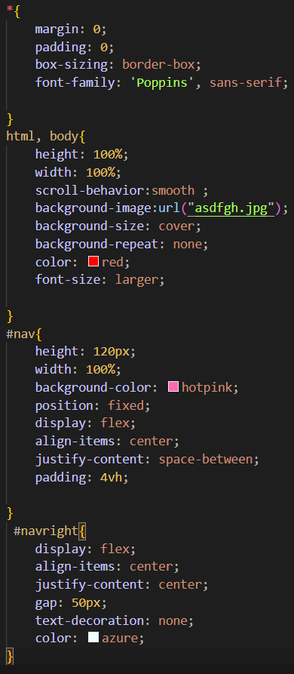
CODE

Slide 9
Conclusion
So, now concluding our Project- “COUNTDOWN TIMER”
I would to like to highlight the main take ways from the project and our experience during the project making.
The project was quite interesting as we learn a lot from the project. This project help us to develop our coding skills in HTML, CSS, JAVA Script more accurately that’s why we are able to develop a webpage to its perfection.
In the upcoming time the there is wide use if this program as upcoming time is fully dependent on technology.
Apart from the skills for developing webpage we also learn how to do teamwork and how to cooperate with all the group members.

Slide 10
References
The project has come to it’s end with help from external sources.
Some of them are follows:
https://www.geeksforgeeks.org/create-countdown-timer-using-javascript/
https://www.w3schools.com/howto/howto_js_countdown.asp
https://css-tricks.com/how-to-create-an-animated-countdown-timer-with-html-css-and-javascript/

